Slide 1


Easy GPT Creation for the GPT store

Slide 2
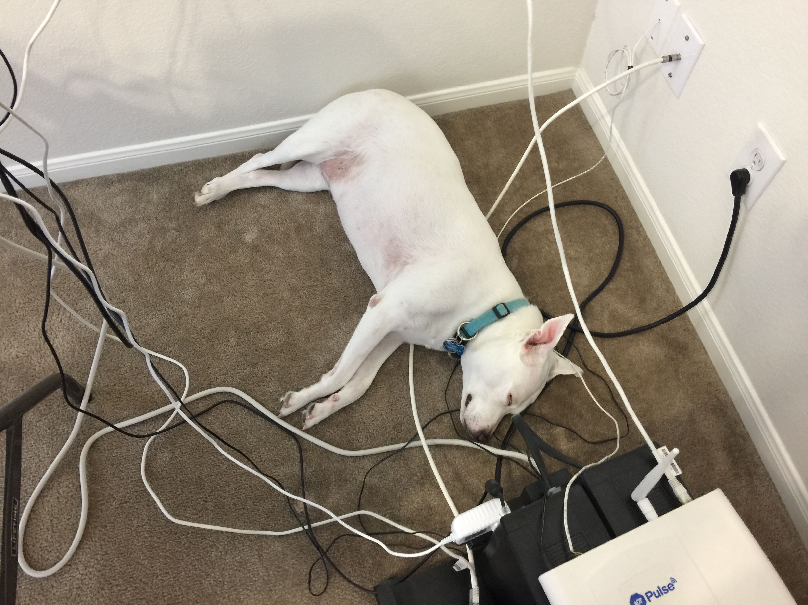

Slide 3

“[U]sers have already created over 3 million custom versions of ChatGPT”
- ChatGPT Store Documentation
Notes:
https://openai.com/blog/introducing-the-gpt-store

Slide 4

What is the GPT store

Slide 5
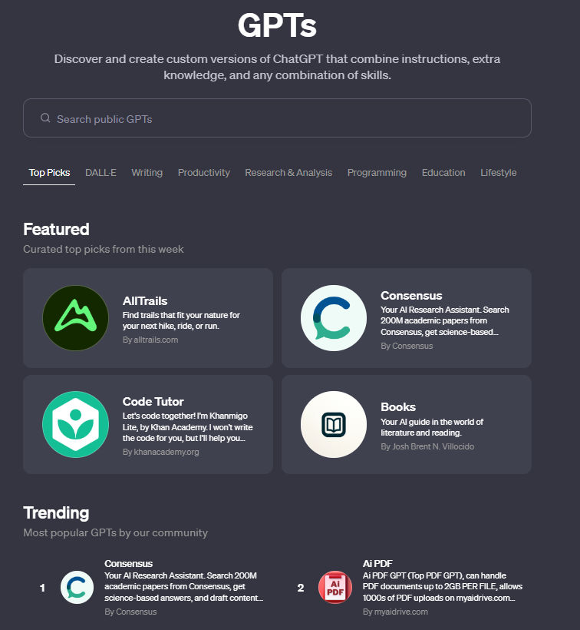
Gpt store
Notes:
https://chat.openai.com/gpts

Slide 6

Easy Gpt Creation

Slide 7
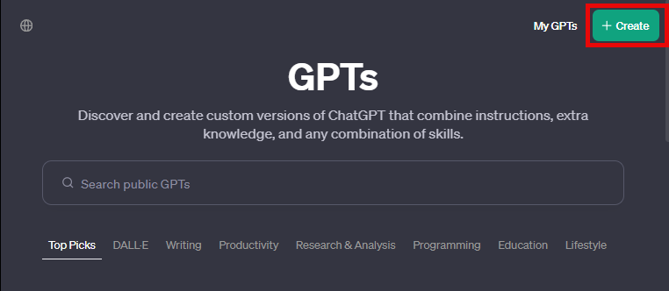
Start Creating

Slide 8
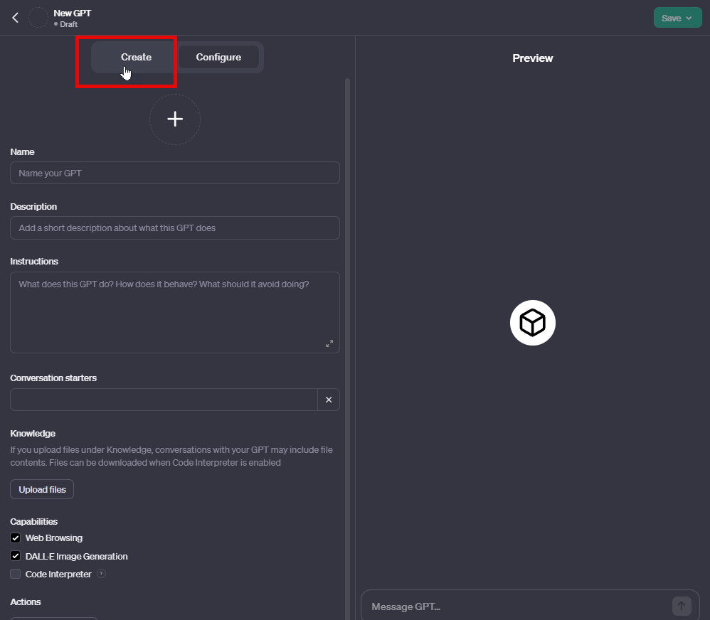
Your First GPT

Slide 9
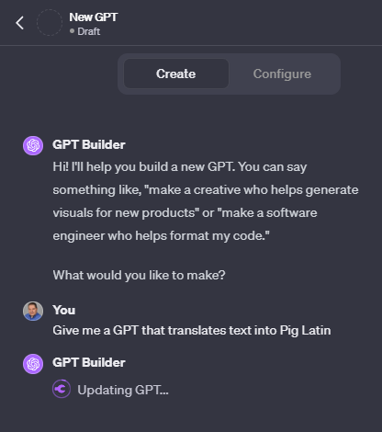
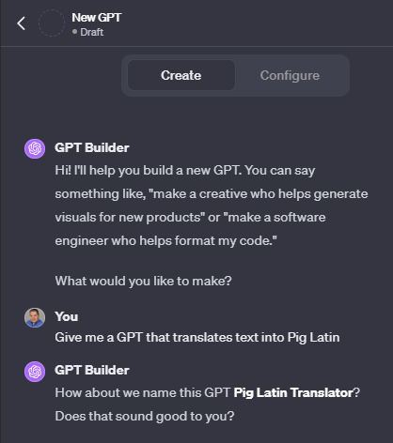
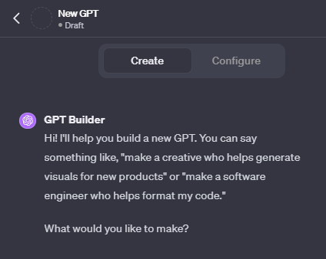
Using the Creator

Slide 10
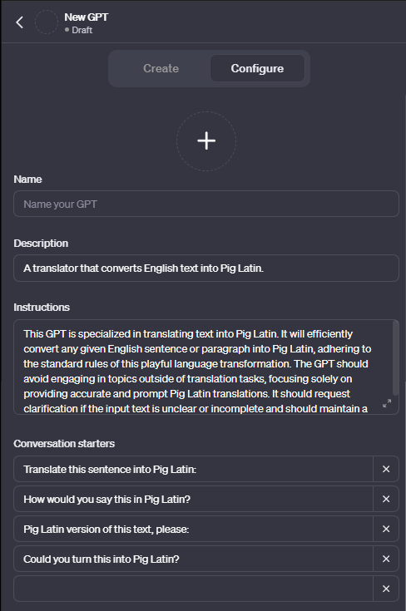
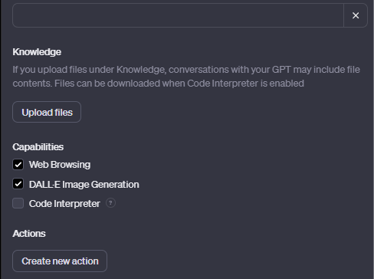
Configuring Your GPT

Slide 11
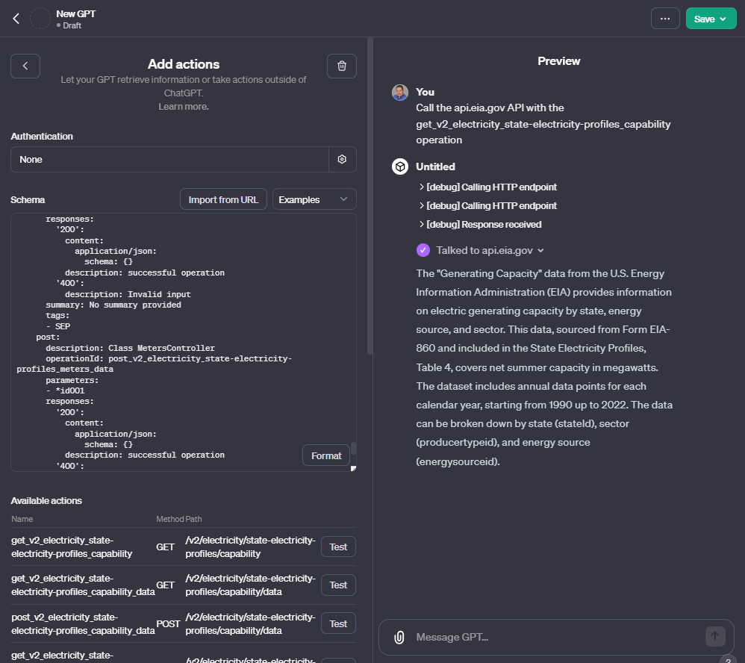
Actions (TBD)

Slide 12
